Slide 1
Project Report Placement Management System
PROJECT BY
Miss. Supriya Sandhyan
GUIDED BY:
Miss. Shalini Kumari
(Technical Trainer)
Java Full-Stack Development
Edubridge

Slide 2
Contents
Introduction
Objectives
Scope
Problem Definition
Advantages
Requirement Specification
Output
Conclusion

Slide 3
Introduction
Every organization, whether big or small, has challenges to overcome and managing the informations of placements, training, colleges, users, registration.
Every training and placement management system has different training needs, therefore we design exclusive placement management system that are adapted to your managerial requirements.
This is designed to assist in strategic planning, and will help you ensure future goals.
The “placement management system” has been developed to override the problems prevailing in the practicing manual system.
This software is supported to eliminate and in some cases reduce the hardships faced by this existring system.

Slide 4
Objectives
To reduce the manual work
To manage the details of registration, placement
To give access only for the administrator
To keep record of all user details and placements
To track the details of the students and placements

Slide 5
Scope
Our project has A big scope to do.
Students can access previous information about placement.
We can stores information of all students.
Various companies can access their information.
Notifications are sent to students about the companies.

Slide 6
Problem Statement
Students choose a specific college where the placement will be held, there is a need to maintain all these papers, causing large amount of space. It is manually done, chances of missing, difficult to handle the details of student.

Slide 7
Advantages
Placement officer can easily collect student’ details, and approve the details provided by them.
As it is an online application, communication with placement officer is easy to students and recruiters, so here intimating about new placements very easy task.
Here recruiters can also search for the details provided by students on the basis of their percentage.
Placement officer can send required materials used for placements preparation to students. With this option preparation for placements becomes easy.

Slide 8
Requirement specifications
SOFTWARE REQUIREMENT | LANGUAGE USED
 | Java
Eclipce IDE | HTML
MySql Workbench 8.0 CE | CSS
 | Springboot
 | MySql

Slide 9
Output Screenshots
Home page
Inserting record
Data stored
Data edit
Date delete
Database

Slide 10
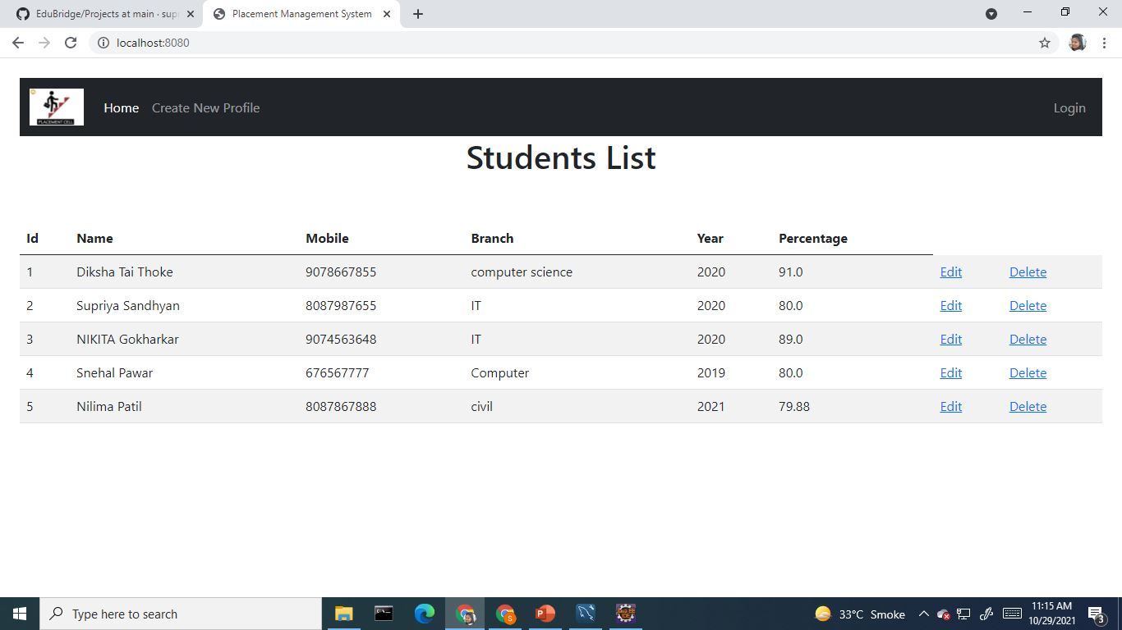
Home Page

Slide 11
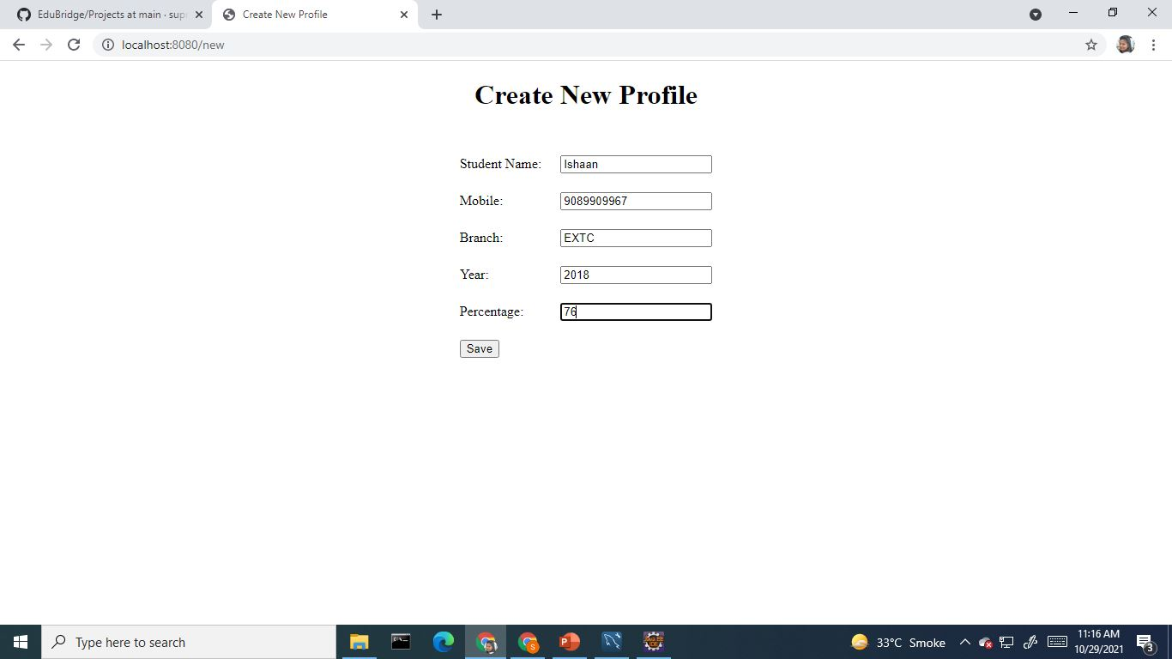
Inserting Data

Slide 12
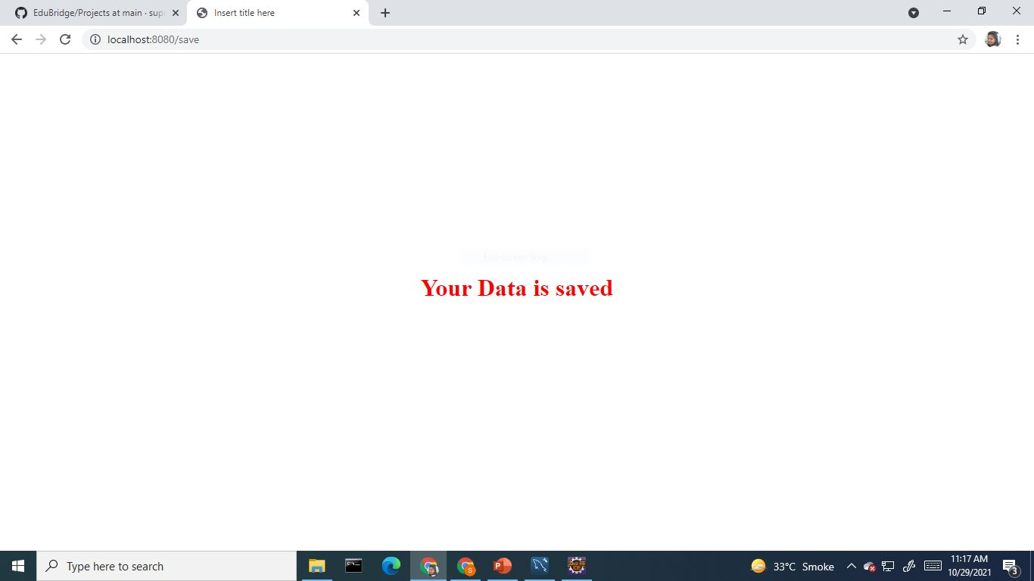
Data Stored

Slide 13
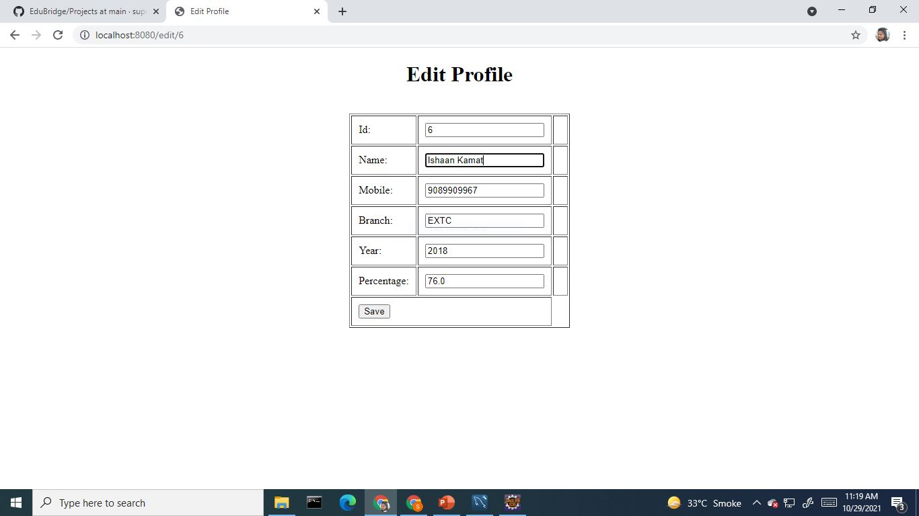
Data Edit

Slide 14
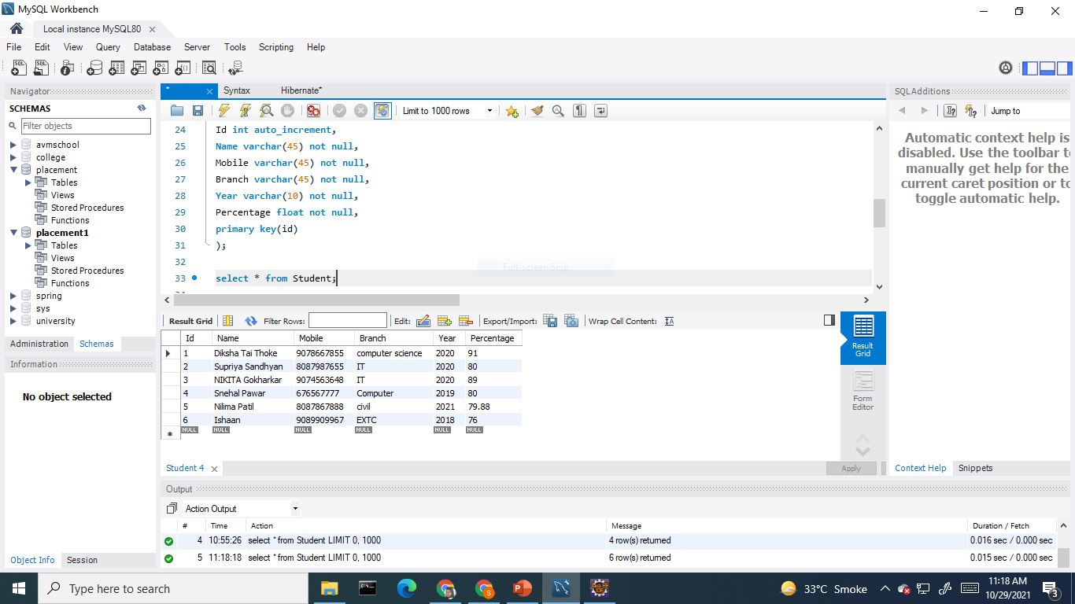
Database

Slide 15
Conclusion
From the proper analysis of positive points and constraints on the component, it can be safely concluded that the system is highly efficient GUI based component. This system is user friendly. Generally the tpo’s of the colleges has to face a lot of problems in management of the students information. This all information has to be managed manually. So, there is a need to develop a system that can solve the mensioned problem. This system comes with just that solution.

Slide 16
THANK YOU

